Slide 1

Mobile cloud computing

Slide 2
History:
Mobile Cloud Networking (MCN) was an EU FP7 Large-scale Integrating Project (IP, 15m Euro) funded by the European Commission. The MCN project was launched in November 2012 for the period of 36 month. The project was coordinated by SAP Research and the ICCLab at the Zurich University of Applied Science. In total 19 top-tier partners from industry and academia established the very first vision of Mobile Cloud Computing.

Slide 3
What is Mobile Cloud Computing?
Mobile cloud computing uses cloud computing to deliver applications to mobiles. The mobile cloud refers to cloud-based data and the applications and services designed for mobile devices. It combines mobile application development with cloud-based services, making the delivery of cloud services and apps to mobile users possible. Cloud-based mobile apps need an internet connection to function.
In mobile cloud computing, the data storage and data processing are moved from mobile device to powerful and centralized computing platforms located in clouds.
These centralized applications are then accessed over the wireless connection based on thin native client or web browser on mobile phones.

Slide 4
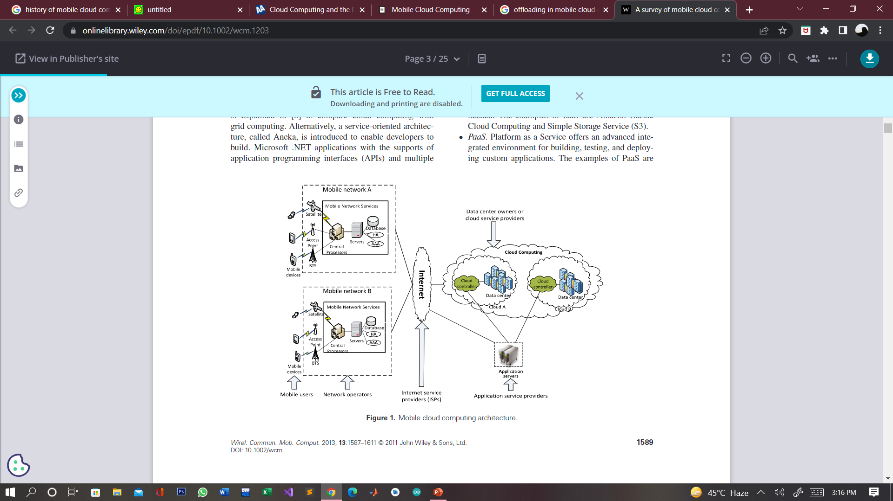
Architecture of MCC

Slide 5
What’s the difference between cloud computing and mobile computing?
Cloud computing is the delivery of computing services over the internet. That includes storage, databases, software, and analytics. It’s a pay-as-you-go service that’s cost-effective and scalable.
Mobile computing allows you to access data and information wherever you are. Mobile computing transports data, voice, and video over a network using a mobile device

Slide 6
Why Choosing MCC?
Rapid Development
Cloud companies are developing mobile applications which are helping customers on daily basis. These applications come up with upgrades which continuously improve the performance of the applications.
As companies are improving their applications regularly this leads to the fact that there is a rapid development in mobile Cloud Computing.
Flexible
The applications built are of greater reach and flexible. There are a variety of development approaches and devices which supported by mobile Cloud Computing. In MCC, the customer can select the services which require for their business which makes it more flexible.
Secure
Mobile Cloud Computing is reliable and backs up all the data in the cloud and keeps it secure. That backed up can retrieve anytime in a secure manner.
These applications protect by a password so that if the mobile is lost or stolen the cloud does not face any risk. From one phone to another the process is very easy and no data is lost.

Slide 7
Factors Fostering Adoption Of Mobile Cloud Computing
Trends and demands: Customers expect convenience in using companies’ websites or applications from anywhere and at any time. Mobile Cloud computing is meant for this purpose. Users always want to access business applications from anywhere, so that they can increase their productivity, even when they are on the commute.
Improved and increased broadband coverage: 3G and 4G along with Wi-Fi, femtocells, are providing better connectivity for mobile devices cloud computing.
Enabling technologies: HTML5, CSS3, a hypervisor for mobile devices, cloudlets and Web 4.0 are enabling technologies that will drive adoption of mobile cloud computing.

Slide 8
Applications And Examples of Mobile Cloud Computing.
Email: Gmail, Outlook, and Yahoo Mail are numerous examples of mobile email. When you check your emails through your smartphone, you’re using mobile cloud computing technology.
Social Media: It enables quick sharing of real-time data on social media platforms like Twitter, Instagram, and Facebook. For example, a video recorded on a mobile device can be saved and shared with another mobile user.
Finance and Commerce: Using phone or tablet to track account balance, making a purchase on ecommerce platforms such as Amazon, Shopify, etc., is an example of mobile cloud computing.
Healthcare: With cloud computing, accessing patient records through a mobile device is simple. Mobile healthcare also permits massive amounts of instantaneous data stored in the cloud, accessible via a mobile device. It enables convenience by allowing access to patient records when needed.
Mobile gaming: With MCC, we can offload the game engine on the mobile cloud which requires large amount of computing. This will help in saving energy and will increase game playing time.
Key-word based , voice based , tag-based searching

Slide 9
Advantages:
Multiple Platform Availability
The cloud computing application introduces by the company, use in multiple platforms such as Android, IOS, and many more. The cloud can easily access and modify regardless of the platform.
Economical
Mobile Cloud Computing eliminates the cost of hardware and it is one of the most cost-efficient methods to use and maintain. Mobile Cloud computing has very less upfront cost in the customer has to pay only for what they have used.
Backup and recovery
The data stored with the help of mobile Cloud application can back up easily and retrieve when in need. Cloud disaster recovery is a plan which consists of storing and maintaining copies of data at several places while keeping the security measures at its peak.
Data Availability
You can get real-time data at your will when you make use of mobile cloud applications. This allows you to get access to your data when you want it and you can also save your data on the cloud when you wish to surf offline.
Extension of battery life:
Since data processing takes place on the cloud, the device’s battery need not do much of the heavy lifting. Therefore, there is less strain on the device battery as a cloud-based application runs in the background.

Slide 10
Disadvantages
Data Privacy
Most of the times the user has sensitive content on the cloud and during the data flow there can be a breach in the network which can lead to the loss of data. It is extremely important to choose the right service provider who will ensure that your data is safe at all times and in any situation.
Connectivity
When the service which you want to use is completely dependent on the internet connection, it is important to see that the connection is up at all the times so that your cloud connection is not being suffered which might affect the transfer of your data.
Low Bandwidth
One of the biggest issues, because the radio resource for wireless networks is much more short than wired networks.

Slide 11
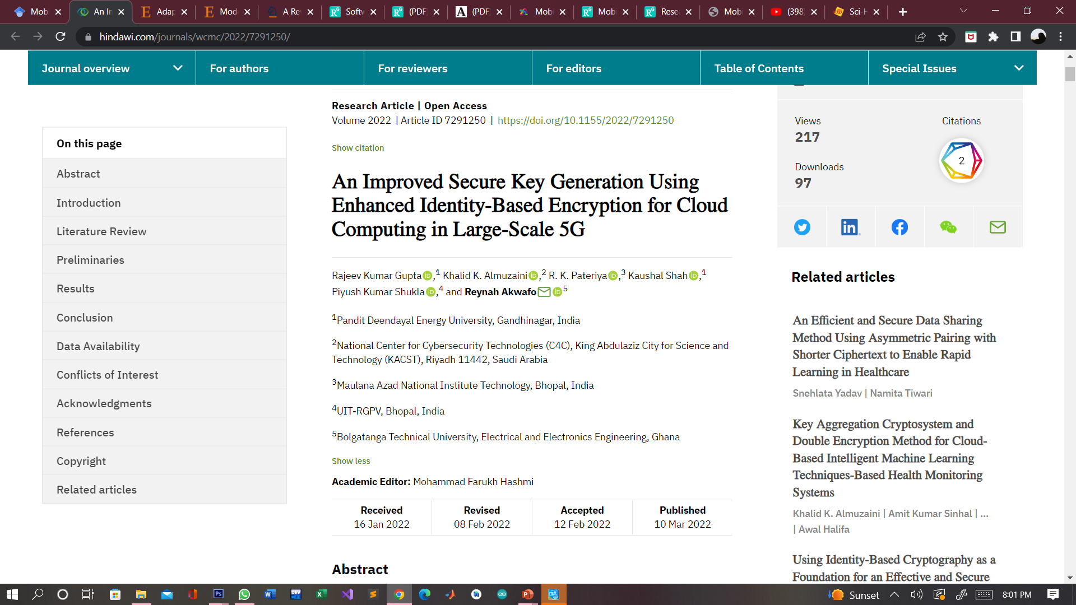

Slide 12
